Slide 1
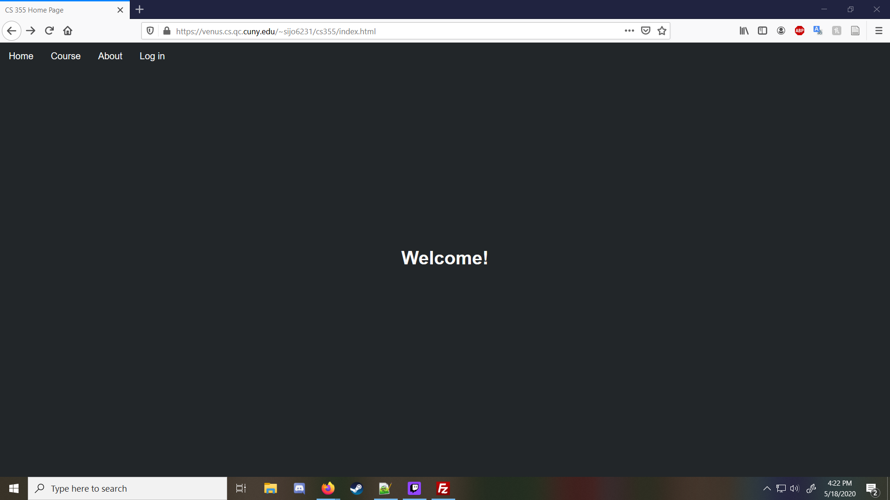
Index Page
Home page from here you can log in or register an account

Slide 2
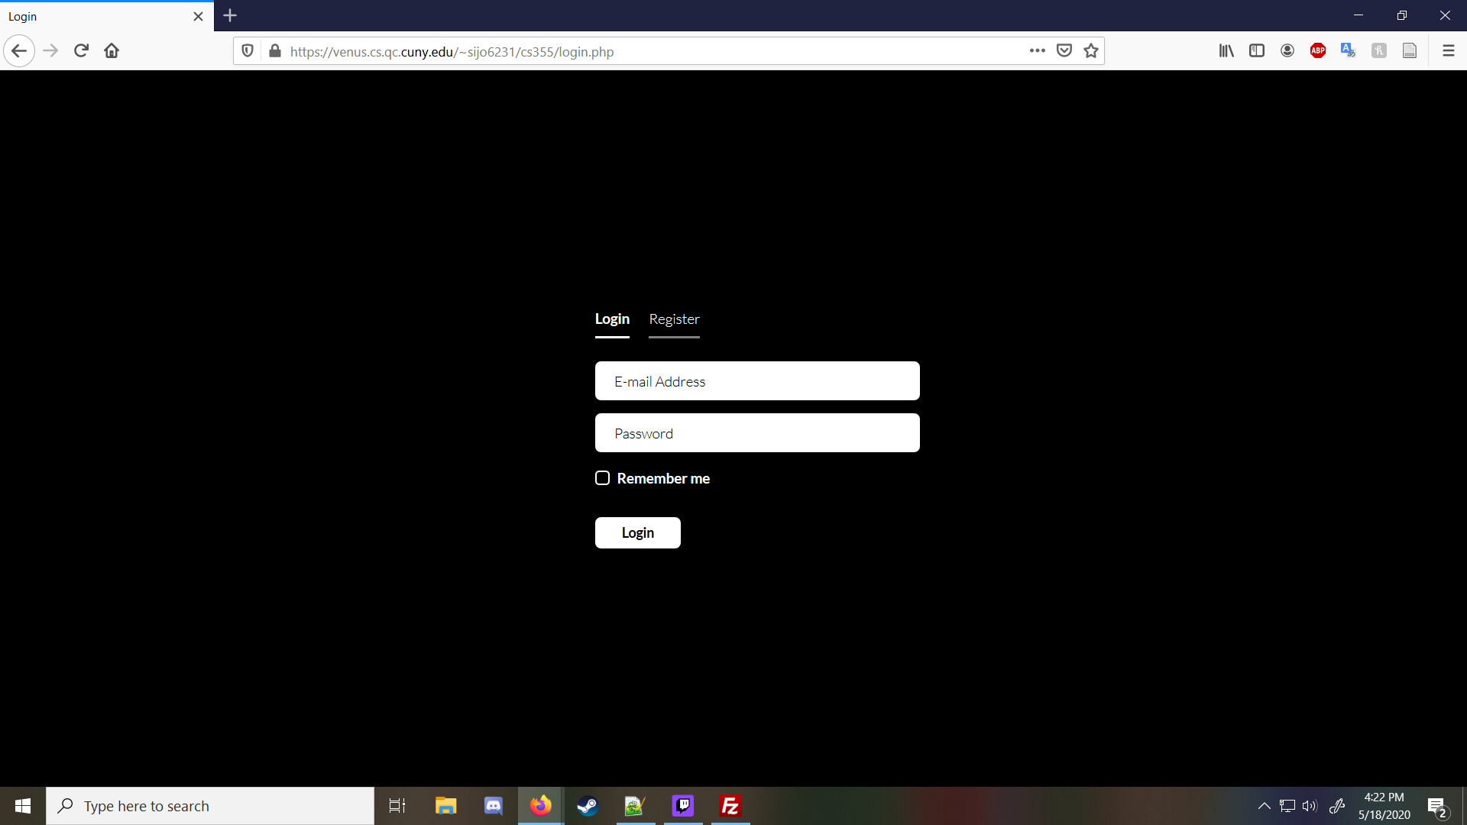
Login Page
If you have an existing account, you can login here with email and your password

Slide 3
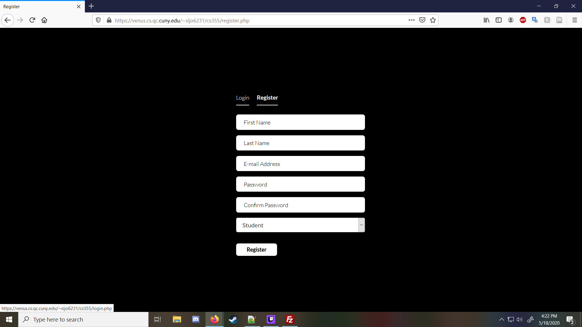
Registration Page
Here you can register for an account using your name, email and create your own password as well as picking which account type you will be, teacher or student

Slide 4
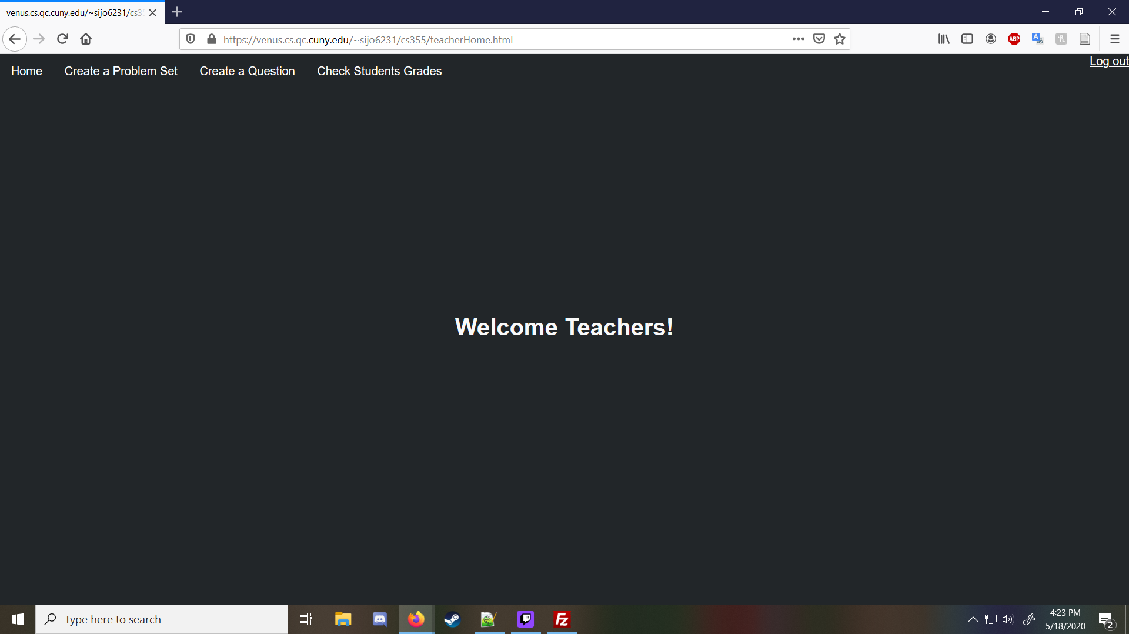
Teacher Home Page
After you login as a teacher you are brought to this page where you can create a problem set, question or check your students work

Slide 5
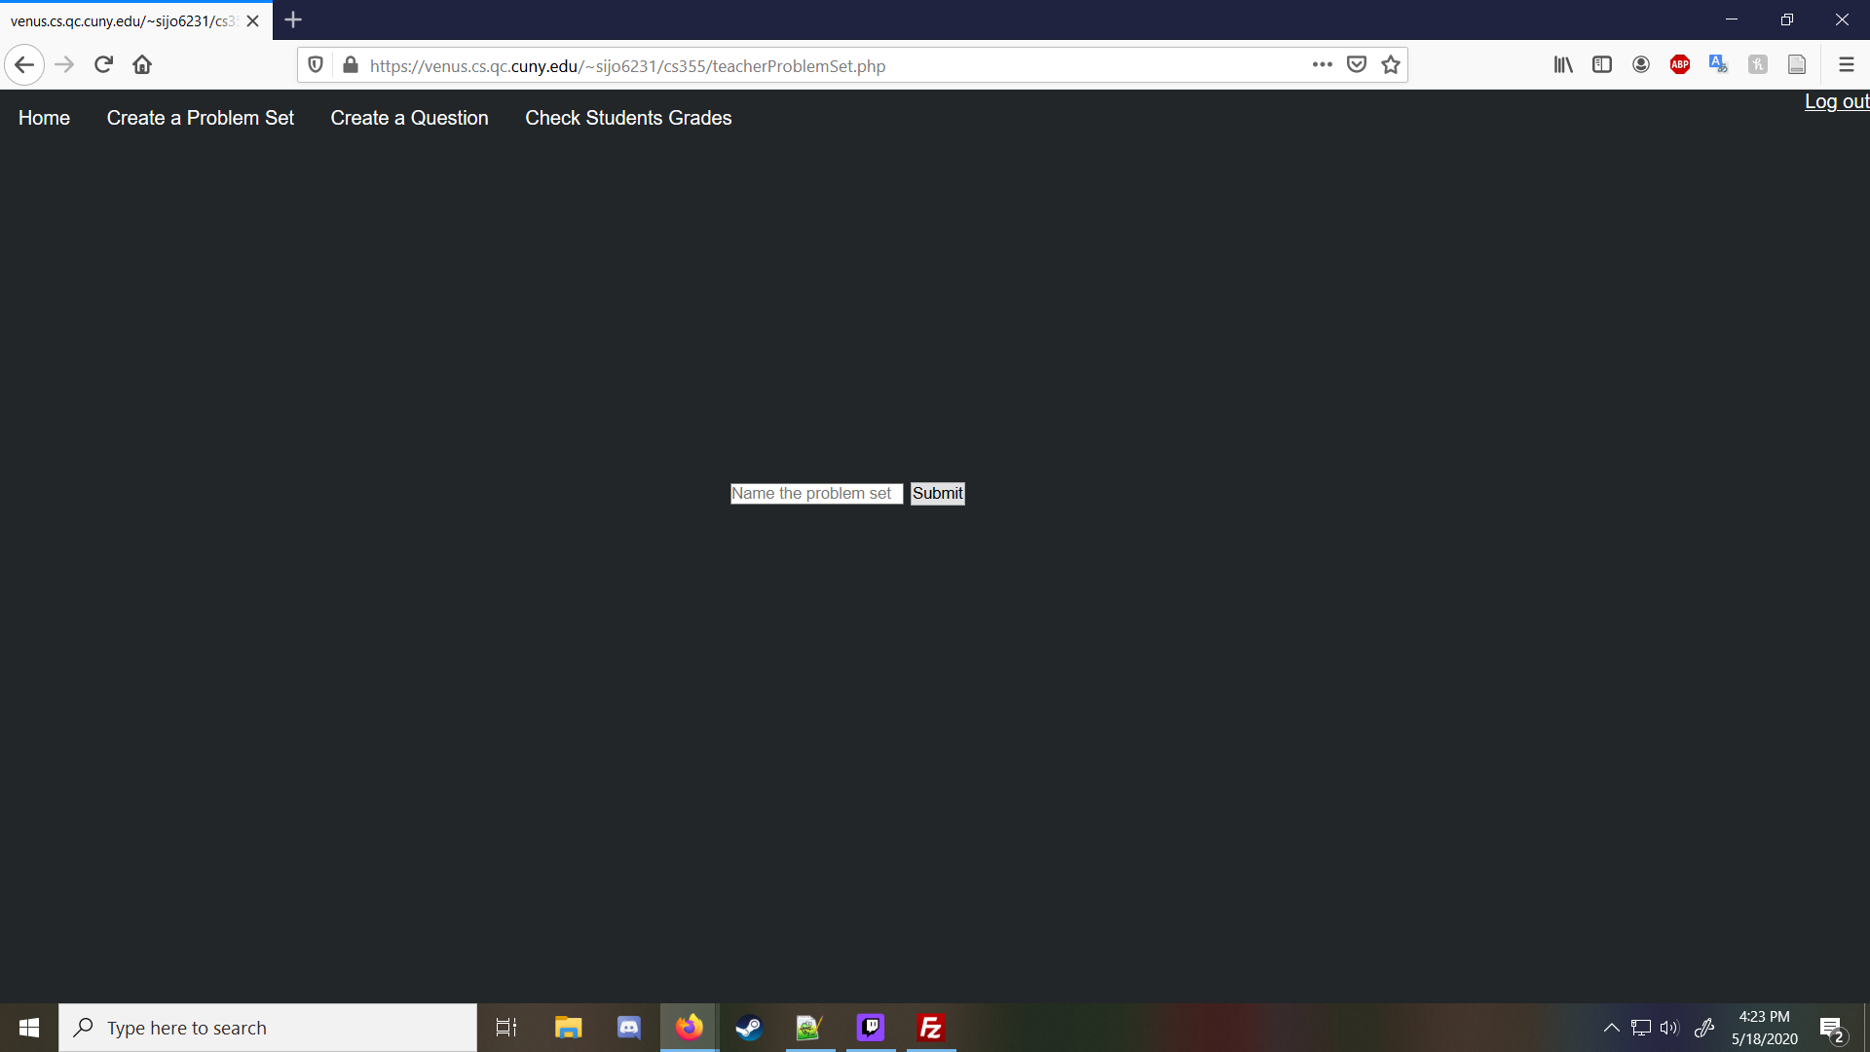
Problem Set Page
Here you can title and create a problem set for your students to work on(because of testing questionset_id starts at 8 here)

Slide 6
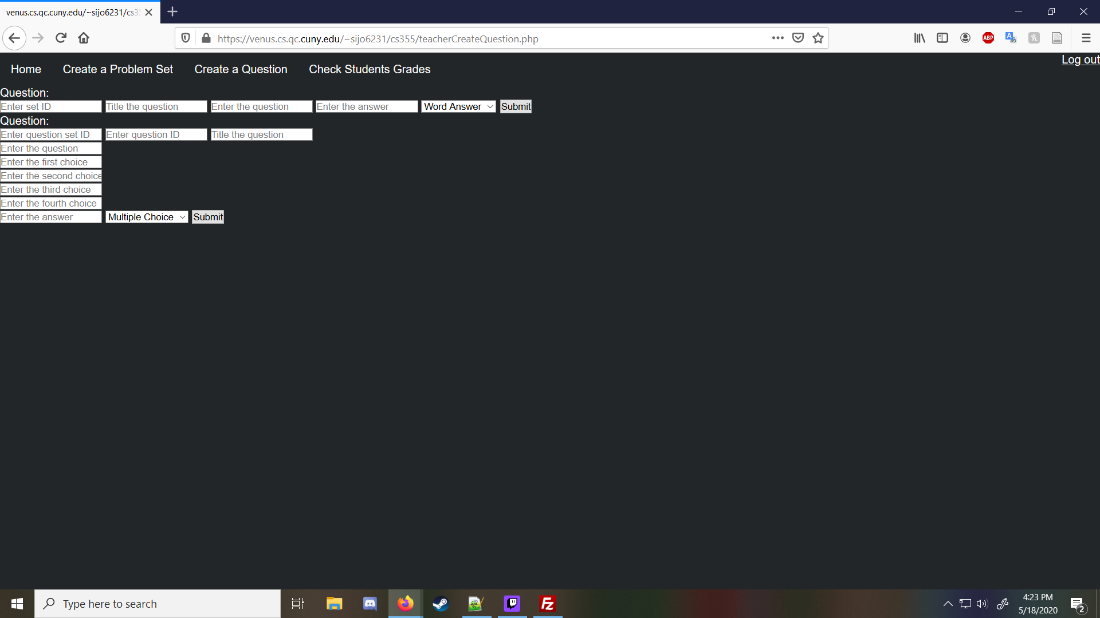
Creating a Problem
Here you can attach questions to problem sets that you have created, multiple choice or word answer

Slide 7
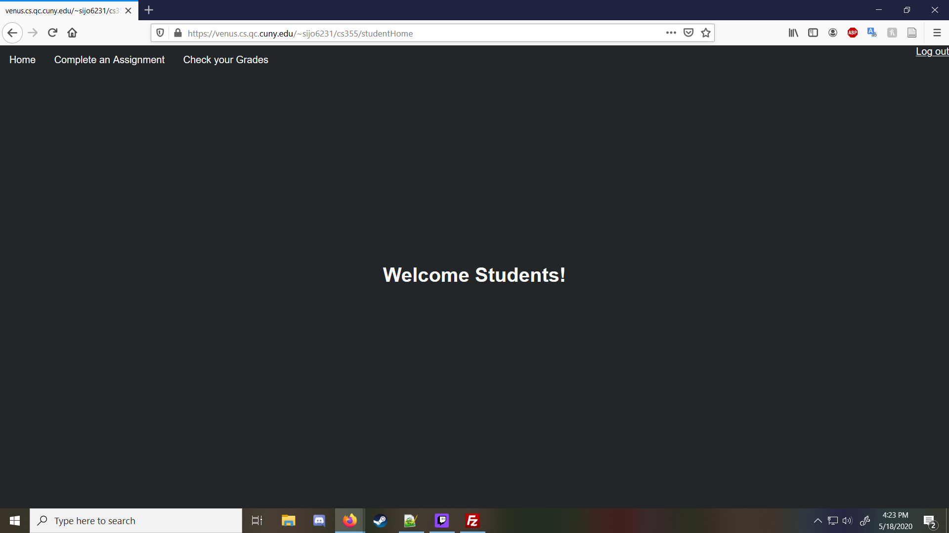
Student Home page
After you login if you are a student account you will be brought here where you can complete assignments and check your grades

Slide 8
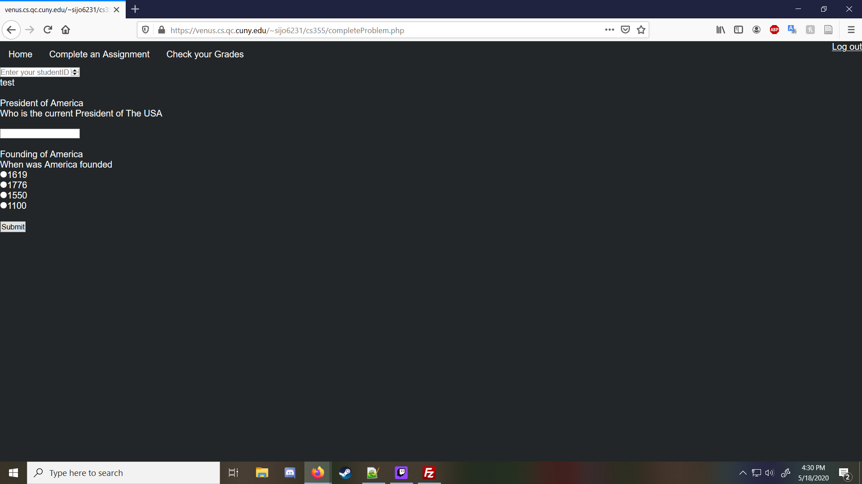
Completing a Problem
Here is where a student can complete some problems that were assigned. Some sample problems are already here. Just enter your student id and answer away.

Slide 9
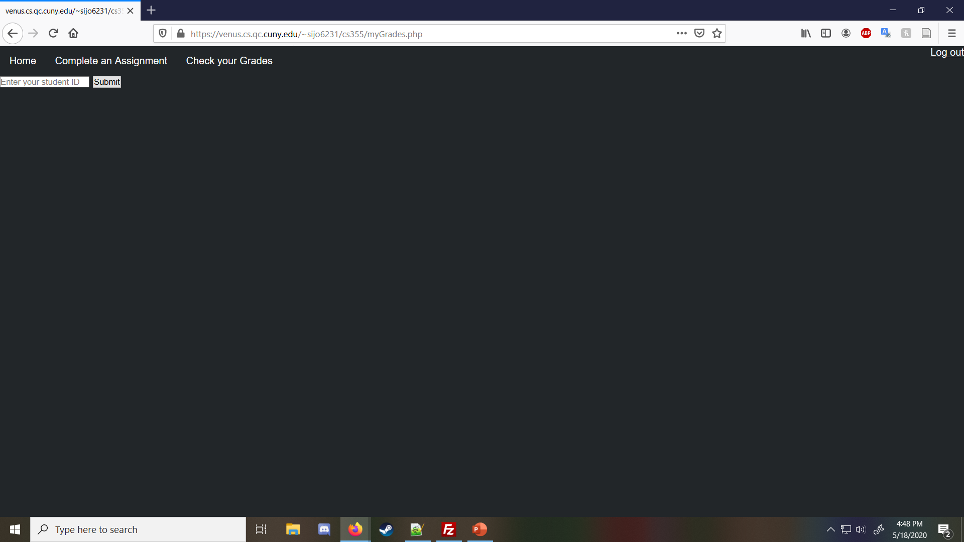
Checking your grades
All you have to do is enter your student id and you can check your grades(since there is testing data in the database every account created now starts at 4 and goes up incremently)

